Slide 1

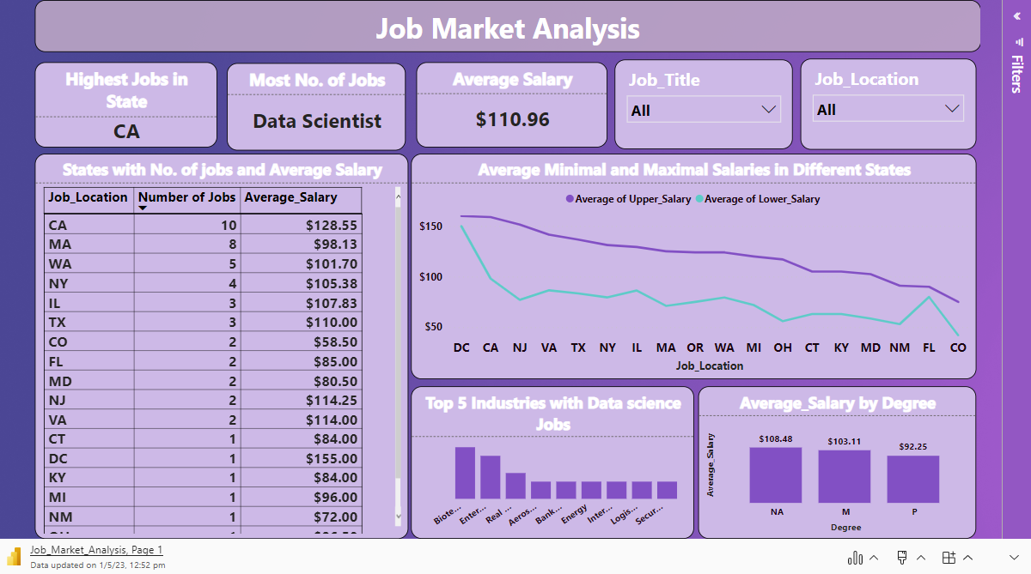
PowerBi Report

Slide 2
